Slide 1

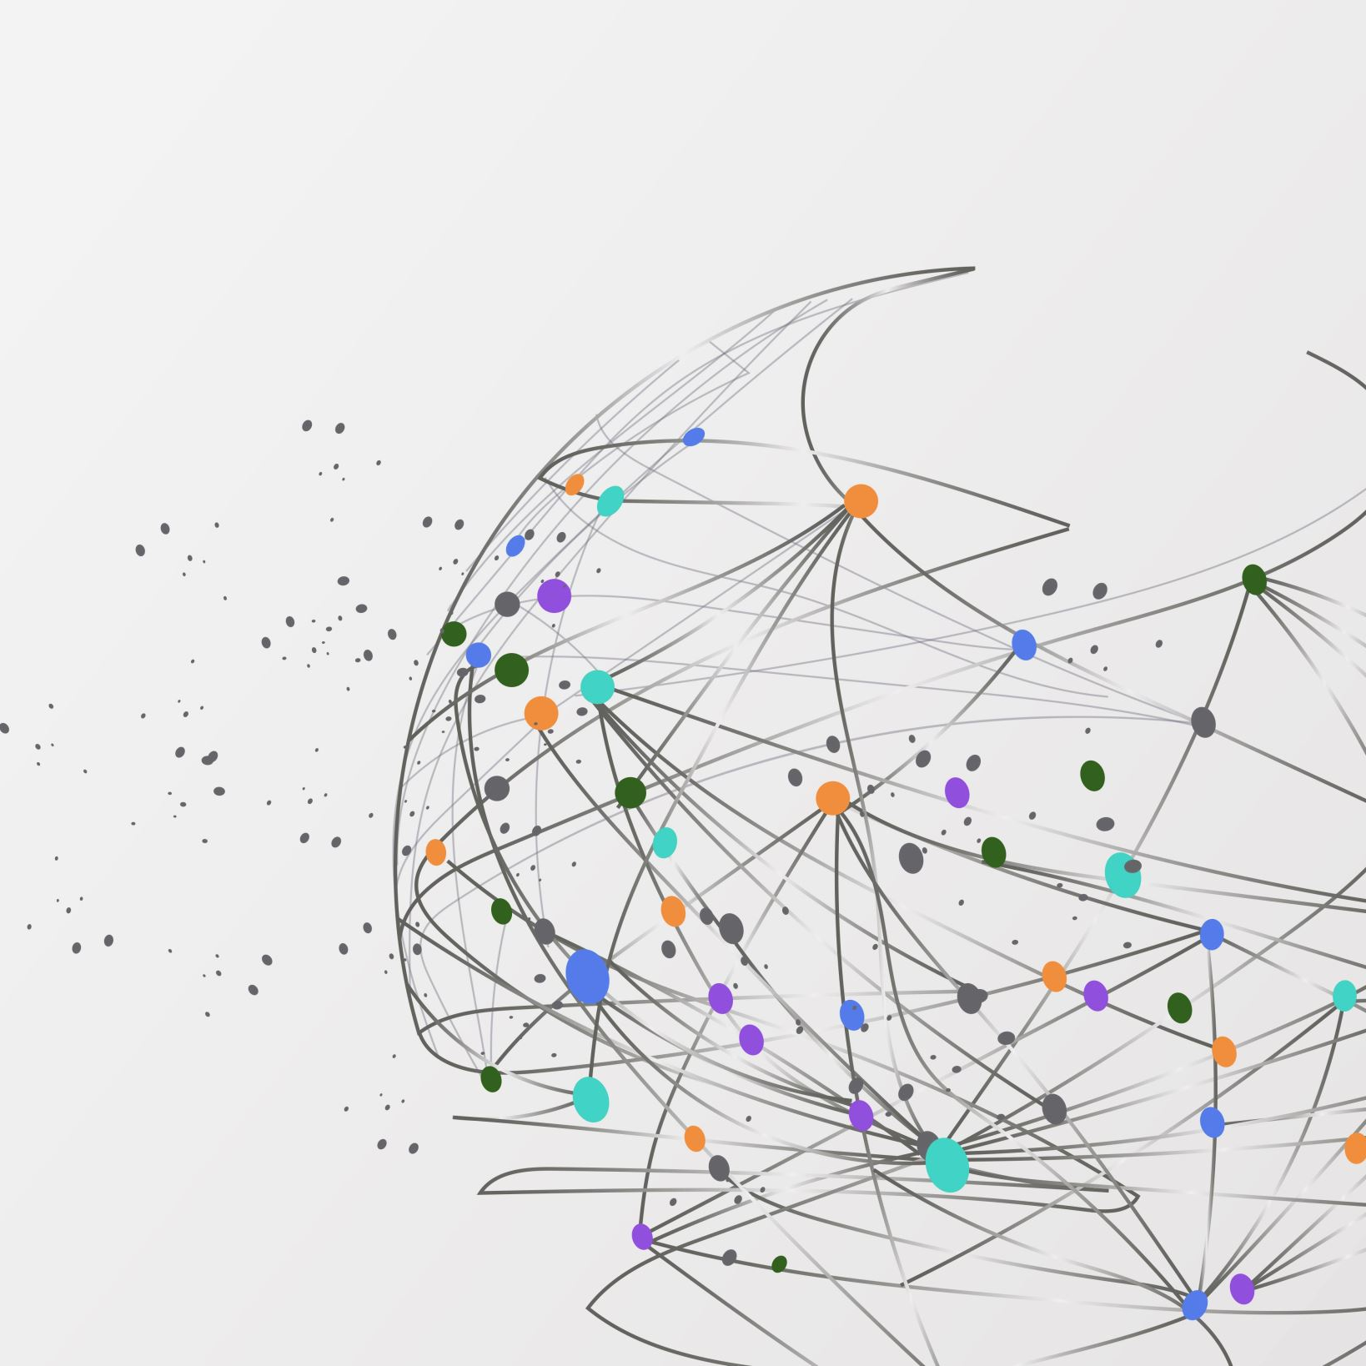
Cloud Deployment Models
Public Cloud, Private Cloud, Hybrid Cloud, and Multicloud

Slide 2



Public Cloud
Definition:
A cloud model where services are delivered over the internet by third-party providers like:
  AWS
  Microsoft Azure
  Google Cloud Platform (GCP)

Slide 3

How it works:
The provider owns and manages the infrastructure.
Anyone can use the services by paying only for what they use.
Users can access services like:
  Virtual machines (VMs)
  Storage
  Databases

Slide 4

Why it’s useful:
No need to buy expensive hardware
Fast setup and easy to scale when your needs grow
Ideal for startups, web apps, and projects with changing demand

Slide 5
Real-life example:
Online Learning Platform
A small institute wants to offer online classes.
Instead of buying and managing servers,
they use the public cloud to:
Host their website and learning materials
Store student data
Run tests and assignments
As more students join, they can quickly increase storage and computing power, without buying new hardware.

Slide 6

Simple analogy
Like renting an apartment
You don’t own the building.
You use shared services (like the gym or pool).
The landlord handles maintenance.
Similarly,
In the public cloud:
You rent computing resources.
The provider manages hardware and updates.

Slide 7
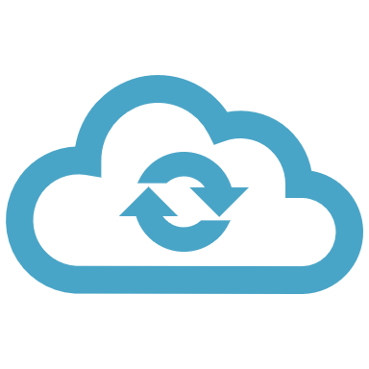
What is Private Cloud?
A private cloud is a type of cloud computing where the entire cloud environment is dedicated to just one organization.
It can be hosted on the company’s own servers or by a provider but not shared with others.
Offers cloud features like virtualization and remote access, but with full control and isolation.

Slide 8
Why is Private Cloud Useful?
High Security: Your data is completely private — no sharing with other customers.
01
Customizable: You can tailor the setup to your exact needs.
02
Compliance: Perfect for businesses with strict rules about data privacy and protection.
03
Full Control: You manage access, performance, and security — just how you want it.
04

Slide 9
How It Works
The cloud is built for just one organization.
Resources (servers, storage, software) are not shared.
Your IT team (or a trusted provider) sets up and manages the system.

Slide 10


Real-Life Example
A university wants to keep student records, exam data, and research secure and private.
They set up a private cloud that only their staff can access.
This helps them meet education privacy laws and ensures full control over how data is used.

Slide 11
Simple Analogy
A private cloud is like owning your own house:
You have full control over it.
You decide who can enter.
You can upgrade, secure, or customize it anytime.

Slide 12

What is Hybrid Cloud?
A hybrid cloud is a combination of public cloud and private cloud working together.
Some data and applications are kept private (for security), while others run on the public cloud (for flexibility and cost).
It allows you to move data or apps between the two as needed.

Slide 13
Why is Hybrid Cloud Useful?
Security where needed: Keep sensitive data safe in private cloud.
Cost savings: Run less-sensitive services on the cheaper public cloud.
Flexible: Use public cloud when you need more resources.
Customizable: Choose what stays private and what goes public based on your needs.
Business continuity: If one system fails, the other can take over.

Slide 14
How It Works
An organization runs secure apps (like finance or HR) in a private cloud.
At the same time, it uses the public cloud for things like websites or customer services.
A secure connection allows the two clouds to communicate and share data when needed.

Slide 15
Real-Life Example
A retail company stores customer payment info in a private cloud for security.
Meanwhile, it runs its online store and promotions in the public cloud to handle high web traffic.
If sales spike during a holiday, the public cloud scales up quickly.
But customer data stays safe in the private cloud.

Slide 16
Simple Analogy
A hybrid cloud is like owning a house with extra storage rented nearby.
You keep valuables at home (private cloud).
You use the rented storage (public cloud) when you have extra stuff or guests.
You choose what stays where — it’s your call

Slide 17

What is Multi-cloud?
Multicloud means using two or more different cloud providers at the same time.
For example, a company might use one cloud for storage and another for data analytics.
Each cloud provider is separate, and services are chosen based on strengths.

Slide 18
Why is Multicloud Useful?
Choose
Best Features: Choose the best tools and services from different providers.
Avoid
Avoid Lock-In: You’re not stuck with just one cloud vendor.
Better
Better Reliability: If one provider has an outage, the other still works.
Use
Performance Optimization: Use the fastest or closest cloud for each task.

Slide 19
How It Works
An organization signs up for multiple cloud services.
01
It uses each one where they’re strongest, like:
02
One for databases
Another for backups
A third for machine learning
Data may or may not move between clouds.
03

Slide 20
Real-Life Example
A media company uses:
One cloud to store and edit videos
Another cloud to run video streaming
A third cloud for global content delivery
This setup ensures high performance, avoids being locked into one provider, and uses the best tool for each job.

Slide 21
Simple Analogy
Multicloud is like shopping at multiple stores.
You buy clothes from one, groceries from another, and electronics from a third — based on what each one does best.
You’re not limited to just one place.

Slide 22
Summary
Public clouds offer scalability and cost-effectiveness but have less control over security and customization.
Private clouds provide high security and customization but come with higher costs and limited scalability.
Hybrid clouds combine the benefits of public and private clouds, allowing for cost optimization and workload balancing.

